Slide 1


Slide 2


2025 Pre-Fair Meeting
Monroe County 4-H
Celebrating The Bounty of the County
2025
Notes:
Welcome to the 2024 Monroe County pre fair meeting we are excited to have all you here this evening
This years fair theme was submitted TQ Adventures and More in 2024. Chelsea and I hope you enjoy our small token of thanks for all the work you do as 4-H leaders

Slide 3
Pledges

Slide 4
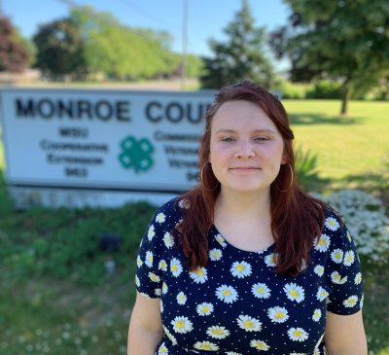
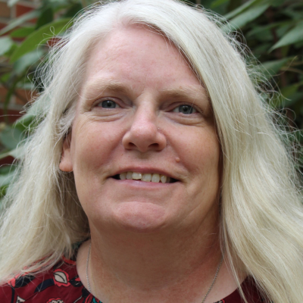
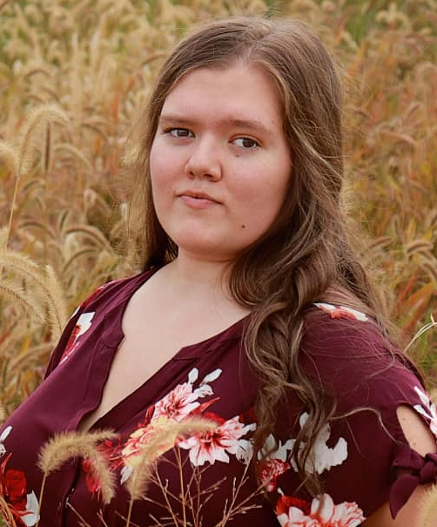
Your Extension Staff
Jean Genaw
Program Coordinator
Chelsea Butler
Program Coordinator
Sarah Rhinehart
Support Staff
734-240-3174
Butle301@msu.edu
734-240-3188
genawjea@msu.edu
734-240-3182
rhineha5@msu.edu
Notes:
Chelsea and I are excited about the upcoming year, 2023 fair and focusing on Monroe Counties 4-H program’s continued Success
Hilary is our new office staff and is off to a great start
Please use direct phone lines and e-mails to reach us.

Slide 5
What’s in your folder?
Parade of Flags
Fair Pass Request Form
Stall Fee Summary
Kitchen Duty/Sign-up
Guard Duty/ Sign-up
How to pull Roster
Fair Entry help sheet
Shooting sports sheet
Cat info sheets
Swine Prohibited Product Affidavit
Kitchen Flyer
Kitchen/ Guard Duty Letter and schedules
Notes:
Info in folder includes…
Club rosters/
the paper clipped items are the forms leaders will return June 17 1-7 pm

Slide 6

Thank you to Complete Contracting Solutions.
Premium Catalogs- available tonight passed out after district meetings limited supply one per family after tonight they can be picked up at the Extension office. Link to digital copy will be on FB, Website and in network (next week).
Fair Entry Open May 15, 2025 to June 09th, 2025 @5:00pm
Sticker deadline June 09th, 2025…Screening and corrections only from June 10th to June 15, 2025
Link: Fairentry.com
***Entries must be submitted online by
June 09th @ 5:00pm
Late entries WILL NOT be accepted! No write ins will be accepted
Fair Entry assistance see May network Video links. Members need to print or forward the fair entry conformation e-mails to leaders
Notes:
Read slide…Thank you to Sponsor …the 2025 fair Premium books are here (distribute/one per family/ future pick ups @ office)
Use this most recent copy.
Any difficulty contact office immediately (734) 240-3188
Species specific requirements
Stress the fair entry registration deadline!!!! Make your club deadlines appropriate to have needed info for turn in!
This PowerPoint will also be added to the county 4-H website for later reference.

Slide 7
Paperwork and
Payment turn in
Club Leaders will turn in paperwork and payments
at the Activity Center
June 16, 2025
2:00pm to 7:00pm
Late payments WILL NOT be accepted!
Kitchen and Guard duty sign-up sheets
Parade of Flags
Fair Pass Request
Stall Fee Summary with payment (payments are not refundable)
Notes:
Paper clipped section
Make your club deadlines appropriate to have needed info for turn in!

Slide 8
Stall fees for 2025 Fair
Sheep & Swine- $18/ head
Horses & Ponies-$18/ head
Beef Cattle- $20/ head
Goats- $10/ head
Poultry & Rabbits $8/pen
Dairy Cattle $5/head
Notes:
New fees

Slide 9
YQCA Training
Members ages 8-19 exhibiting Market animals must complete YQCA training to be eligible to show at the Monroe County Fair
link www.yqcaprogram.org
Must be Completed by June 09, 2025
Copy of cert must be provided to office. Submit certificate to YQCA google submission form https://forms.gle/wY23xBgeJ4AyrT3a8 link in network
MSU is an affirmative-action, equal-opportunity employer. Michigan State University Extension programs and materials are open to all without regard to race, color, national origin, gender, gender identity, religion, age, height, weight, disability, political beliefs, sexual orientation, marital status, family status or veteran status.
Notes:
Upload your certifications
Show network page

Slide 10
Junior Superintendents
Google form is in the May network please use the link to sign-up youth
Please submit applications by June 09th
Great leadership opportunity
Notes:
Age 12
Very important for youth to understand that they must see through all their duties. If they are supposed to be helping with a craft area, their responsibility includes Thursday drop-off, Friday judging AND Monday pick-up. Understand that they may need to enter their own projects and/or participate in communications on Friday, but should promptly report back to their Superintendent.
Superintendents please recruit your junior superintendent(s)
Debbie Kraftchick is the coordinator of this program

Slide 11
Crafts I and II
Brenda Chandonnet, Rylie Crots
Angela Michel & Tina LaPlante
New projects:
Section 893
Coloring Pages
Section 894
Stepping stones
Changes:
Soap Making- now includes soaps made with Lye
Needlework- 6 project areas 4-Hers can enter one projects in each area
Frozen Foods- now includes frozen deserts
Cake Decorating-and Other Cake Decorating are now combined
Pet Treats-Judged on Thursday projects will not be kept to display
Painting- Mixed media combination of any painting project
Drawing- Mixed media combination of any drawing project area
Notes:
Brenda, Tina, & Angela
Care should be taken to read both the general rules for my departments and the rules under each section.
I am looking for Superintendents for both my buildings and to please Brenda. Chelsea entrepreneurship program.

Slide 12
Educational Building
    New Projects
    Genealogy- Can use your own family tree forms, or use forms available at the office.
    Forging- added to welding and Soldering
    Deleted areas
    Picnic Baskets
Jackie Manwell & Roni Worden
Notes:
Read you premium on rules

Slide 13
Shooting Sports
Denise Williams
419-280-1332
Upcoming County Qualifiers:
April 24th at Monroe County Rod & Gun Club 6:00 PM (completed)
May 15th at Carleton Sportsman's Club 6:30 PM
June 5th @ Monroe County Rod & Gun Club 6:00 PM
Youth involved in shooting sports must join a shooting sports club with a certified 4-H shooting sports instructor as a project leader. Youth are required to practice a minimum of two practices with their club, attend one county qualifier, and fill out the appropriate classes in fair entry. Youth 8 and older, depending on the division. Cloverbuds can join the Wildlife & Conservation Club to learn about hunting, tracking, and various nature facts.
**all youth shooting in the July 12th fair shoot must attend one county qualifier to compete at the fair shoot and attend two club practices.
Set up for the fair shoot: Thursday, July 10 th 6:00 PM at Monroe County Road & Gun Club (all clubs need representation, asking for 5 each)
Monroe County Fair Shoot: Saturday, July 12th at Monroe County Road & Gun Club 8:30 AM check-in, YOUTH MUST ARRIVE BEFORE 9:00 AM
Notes:
See paper light blue paper in folder with additional information

Slide 14
Produce & Horticulture
Dennis Winter & Kevin Lomas
Phone 734-529-5091
Reminders:
  Check rules for container sizes as there have been changes
  Read premium catalog for rules including day(either Thursday or Saturday) and times that each project will be checked in at fair
Notes:
Dennis & Kevin
Page 115

Slide 15
Jr. Livestock Association
Dave Reaume & Steve Haws
Important Dates
    Sheep and Swine Tagging May 03th Anderson Arena 8:00 am to 10:00 am enter through D lot.
    JLA requires first year showers in project areas to attend JLA species clinic, to be eligible to show at the Monroe County Fair. The June 03, 2025 fitting and showing clinic is your last chance to meet this requirement, Starts at 6:00 pm on fairgrounds. (Dairy and Goats start at 7pm)
    Haul-in schedule for fair Beef 12:00 noon to 2:00pm Saturday
Deleted projects
Llama and Alpacas Program has been deleted
Notes:
Rick, Justin
First time showman
Auction order Dairy Milk, swine, sheep, Beef
Please stress the importance of having exhibitors cash their checks in a timely manner. Checks MUST be cashed within 60 days from JLA banquet otherwise VOID.
Sheep and Swine Tagging: Saturday 5/11 Time. Swine exhibitors will need to bring proof of swine flu vaccination otherwise will be vaccinated onsite

Slide 16
Read Premium Book both general and project specific rules
Limited to 4 pens in the Small Animal Barn(Does not include cavies, pocket pets and Pigeons)
SAA MUST attend one workshop each year
  Fitting & Showing Clinic (LAST CHANCE) Sign-in legibly!
    Tuesday, June 3th 6:00pm @ Fairgrounds/Small Animal Barn
Small Animals
Ron Bash, Tim Henes, Jeff Linn, Susan Arting
Changes
2 New Rabbit Breeds
2 Rabbit Breeds eliminated
Broilers are 1 week older to manage pin feathers
Tie Breaker information in Premium book

Slide 17
Dogs/ Cats
Cats Kim Cramer
Dogs Lori Shaw

Slide 18
Communications
Sign-up Thursday outside of the 4-H Headquarters office of Check-in. Thursday of Check-in starting at 7:00pm
Deleted areas: Poetry Writing and Presentation
By Invitation Only/ Silver Ribbon
Presentations will be Tuesday, Wednesday, Friday @ 10:30am-11:30 am-White Entertainment Tent (check out projects before presentation then return after). Silver awards will be placed on projects.
Judging
Communications judged on Friday 7/25/2025 starting at 9:00am ends at noon. Must check –in before 11:00 am with each category
Michelle McLaughlin
Lori Jo Couch
(734)740-7114
Notes:
Michelle & Lori Jo
Talent Showcase-New time-Wednesday at 4:00 p.m.

Slide 19
Horse & Pony
Nicole Calhoun & Chelsea Wright
Main Communication is through the Horse and Pony members Only Facebook page and Monthly meetings on the 2nd Monday of the Month.
MUST be in a horse club to participate in Horse and Horseless projects.
Leveling show MAY 10-11th
Must complete 6 volunteer hours to show at fair
    work bees start in June on Tuesdays
Mandatory meetings (must attend 1) in person with a parent
Must exhibit at one show to show at fair
Horse & Pony Shows
June 6-8, 2025 ***No haul out during fair week***
June 20-22, June 28th
July 18-20
Notes:
Pod cast

Slide 20
Awards
Debbie Kraftchick Debbra.kraftchick@utoledo.edu
& Brenda Martin
Trophy and Award Sponsorship payments are
  due June 01, 2025
Cost change for Large trophies $35.00
Others remain at $25.00.
MSU is an affirmative-action, equal-opportunity employer. Michigan State University Extension programs and materials are open to all without regard to race, color, national origin, gender, gender identity, religion, age, height, weight, disability, political beliefs, sexual orientation, marital status, family status or veteran status.
Notes:
Debbie & Brenda
Name plates

Slide 21
Human Resources
Kitchen duty & Guard duty time Important role that
Forms will be turned in on June 16, 2025 at paper turn-in
Please complete forms with names and addresses legibly
Make it a priority to have the volunteer who signed up be the one that works the shift.
Patti Wartinger (734)-777-0493
Autum Shipe (734) 430-6193
Notes:
Patti and Kim
Volunteers are essential to running the kitchen and guard duty…Thank you for your assistance
Check your sheets please

Slide 22
Cloverbud
Recognition
Thank you to Directions Credit Union Sponsor
Thursday, July 31, 2025 @ The Andersons Livestock Arena Check in at 3:30 and start at 4:00
Each Cloverbud in attendance will be recognized by name and given a small trophy, green rosette-style ribbon and T-Shirt
Responsibility of the club leader to inform/invite the Cloverbuds and their families
.
Notes:
Debbie Kraftchick, Brenda Martin,
The Clover Bud Recognition is THURSDAY of Fair Week – 8/1 this year – beginning at 4 PM in the Anderson Show Arena
Clover Buds will be recognized by name and given a small trophy, green rosette-style ribbon and more.
Check-in begins at 3:30 PM

Slide 23

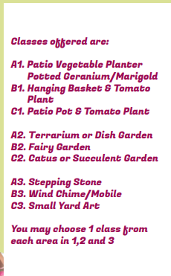

Green Thumb Expo

Slide 24
4-H night @ Flat Rock speedway
June 21, 2025
Gate 5:00 pm
Race 7:00 pm start
Will post on FB when tickets arrive at the office

Slide 25


Slide 26
Other important Items
READ THE NETWORK!!!!
Work Bees Start June every Tuesday at 6:00pm
June 3th Fitting and Showing clinic 6:00pm at fair grounds
June 9th Deadline for Fair Entry and YQCA
June 16 Paperwork turn-in 2:00 to 7:00pm
All BARN SET-UP July 8th @ 6:00pm

Slide 27
District appointments and voting
Importance of Council
INFORMATION REGARDING ELECTIONS/VOTING
Council bylaws state that ALL 4-H leaders, parents, and members are eligible to vote for Council members.
Voters required to indicate the district they belong to and are limited to voting within their Primary district.
We accept nominations for district representation up to and including Fair Registration Day, with write-ins being accepted through the conclusion of Saturday project check-in day.
Elections will be held during all three Fair project check-in days (Thursday, Friday, and Saturday) QR code available at the 4-H Headquarters.
In the event an elected youth or adult declines the role, the individual with next highest vote count will fill the position.

Slide 28
District Meetings
Airport
Bedford
Custer
Dundee
  Please review Nominations for council
  Premium Catalogs will be distributed after District meetings.
  ONE PER FAMILY

Slide 29


Slide 30
THANK YOU!
Have a safe drive home

Slide 31

Notes:
Welcome club leaders and representatives. Thank you for scheduling the time to be her tonight to receive valuable information related to the 2023 MCF.
Lets start with our Pledges

